Slide 1
Azure Storage - Blob
SoftUni Team
Technical Trainers
Software University
https://softuni.bg

Slide 2
Questions
sli.do #csharp-web

Slide 3

Azure Storage

Slide 4
What is Azure Storage?
It offers a massively scalable object store, for data objects, a file system service for the cloud, messaging store and NoSQL store
Azure Storage is:
Durable
Secure
Scalable
Managed
Accessible
4

Slide 5
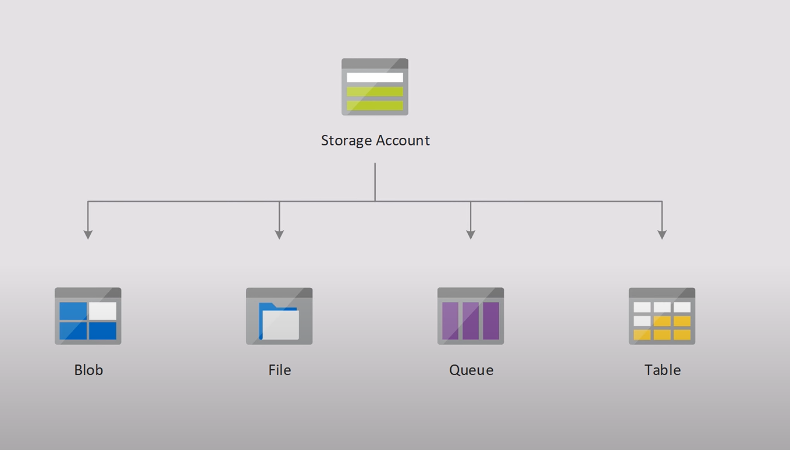
What is Reflection?
5

Slide 6
Blob Storage
A massively scalable object store for text and binary data
Any kind of a file
Ideal for:
Images or documents directly to a browser
Files for distrusted access
Video and Audio
Backup, restoring, recovering, archiving

Slide 7
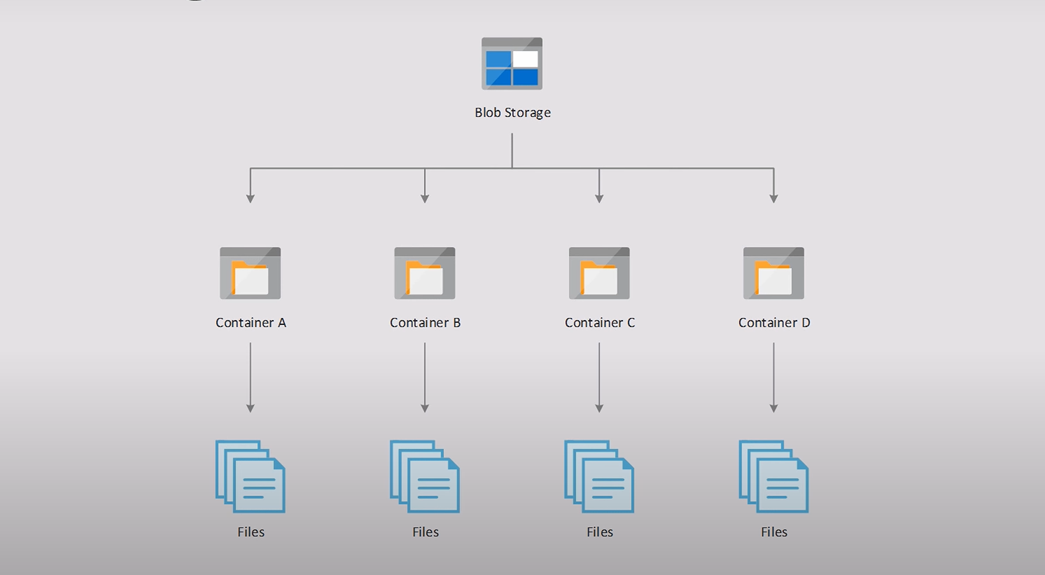

Slide 8
Blob Storage Access Tier
Hot
Optimized for frequent access of objects
Cool
Optimized for storing large amount of data
Infrequently accessed
Stored at lest for 30 days
Archive
Optimized for data that can tolerate latency

Slide 9
Get Image
public async Task<FileStreamResult> Image(string image)
{
var containerClient = blobService.GetBlobContainerClient("images");
var blob = containerClient.GetBlobClient(image);
var result = await blob.DownloadAsync();
return File(result.Value.Content, result.Value.ContentType);
}

Slide 10
Upload Image
[HttpPost]
public async Task<IActionResult> UploadImage(ImageInputModel model)
{
var containerClient = blobService.GetBlobContainerClient("images");
BlobClient blobClient = containerClient.GetBlobClient(Guid.NewGuid().ToString());
byte[] destinationImage;
await using (var memoryStream = new MemoryStream())
{
await model.CustomFile.CopyToAsync(memoryStream);
destinationImage = memoryStream.ToArray();
memoryStream.Position = 0;
await blobClient.UploadAsync(memoryStream);
}
return this.Ok();
}

Slide 11
Get Image Names
public async Task<IActionResult> Index()
{
var containerClient = blobService.GetBlobContainerClient("images");
var resultSegment = containerClient.GetBlobsAsync();
var list = new List<string>();
await foreach (var blobPage in resultSegment)
{
list.Add(blobPage.Name);
}
this.ViewBag.List = list;
return View();
}

Slide 13
Questions?
Notes:
13

Slide 14
Trainings @ Software University (SoftUni)
Software University – High-Quality Education, Profession and Job for Software Developers
softuni.bg, about.softuni.bg
Software University Foundation
softuni.foundation
Software University @ Facebook
facebook.com/SoftwareUniversity
Software University Forums
forum.softuni.bg
14
Notes:
14

Slide 15

License
This course (slides, examples, demos, exercises, homework, documents, videos and other assets) is copyrighted content
Unauthorized copy, reproduction or use is illegal
© SoftUni – https://about.softuni.bg
© Software University – https://softuni.bg
Notes:
15

